Slide 1


Global Household Electrification
Saturday, 2nd September 23

Slide 2


Presentation by Team GCP
List of Active Members
Adebesin Aramide
Kayode Jesujana
Obinna Nwachukwu
Ridwan Abdurahman
David Udosen
Godwin Ehizojie Michael
Emmanuel Christopher
Gopal Kumar
Oluwatomisin Arokodare
Abdul Basit Solkar
Elizabeth Abodunrin
Gloriah Mwongeli Munyao
Adedolapo Ogunlade
Nivedha S
Godwin Ehizojie
Nivedha
Presenters

Slide 3
PROBLEM STATEMENT
Extensive research has been conducted on household electrification challenges in Sub-Saharan Africa, the variations in access to electricity within OECD (Organization for Economic Cooperation and Development) countries remain an underexplored area of study. Despite being characterized by high levels of economic development, certain segments of populations within OECD countries continue to face inadequate access to electricity, hindering their socio-economic progress and well-being. The current electrification datasets present a significant challenge due to their inconsistency, inaccuracy, and limited availability. These shortcomings have the potential to impede informed and effective decision-making processes.

Slide 4
OBJECTIVES
The primary aim of this project is to develop a global household predictive model with a specific focus solely on OECD countries.
Incorporate advance machine learning techniques and additional dataset to refine the models accuracy
Perform some analysis to uncover patterns, correlations and trends within the dataset to extract some valuable information

Slide 5
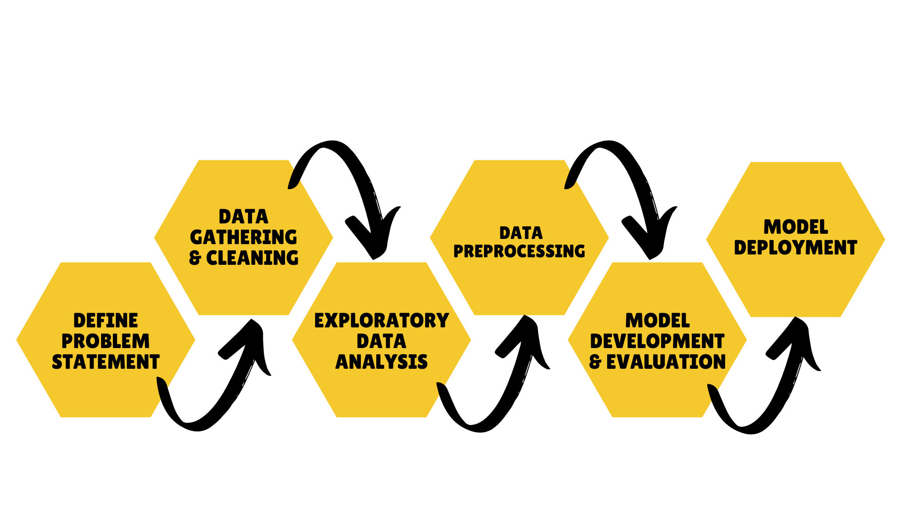

FLOW PROCESS

Slide 6
THE DATASETS
Given Dataset: The provided dataset from the International Energy Agency (IEA) served as the core dataset with 132019 rows from 2010 to 2023
Electricity Generation Data: This is the dataset gotten from data.world consisting of 4075 rows from 1960 to 2017.
World Bank Rural Percentage Data: This dataset contains information on the percentage of rural population in each country. We used this dataset to generate new features for our dataset , such as rural electrification and urban electrification rate in OECD countries.

Slide 7

DATA PREPARATION
Data Cleaning was done on all the three datasets
Generate urban population feature from the rural data
All the three datasets were merged together with the generated urban population feature
Generate electric rural rate and electric urban rate from the merged data

Slide 8
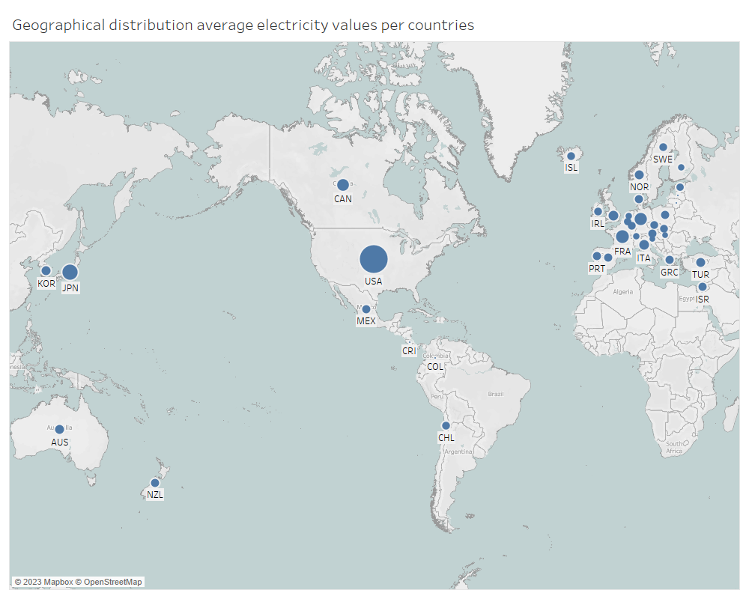
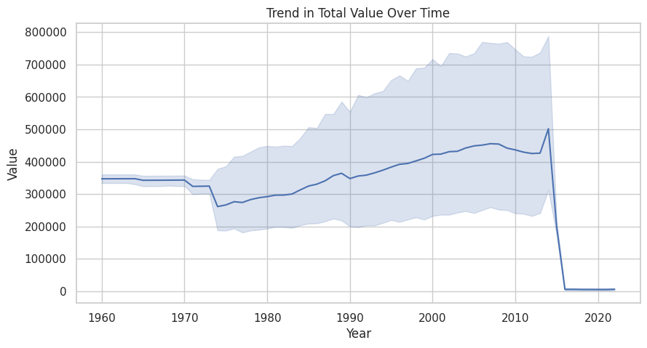
Exploratory Data Analysis (EDA)
The geographical distribution of average electricity values indicates that the United States (USA) has the highest values.
The trend in total value over time reveals that the year 2014 exhibits the highest electric value

Slide 9
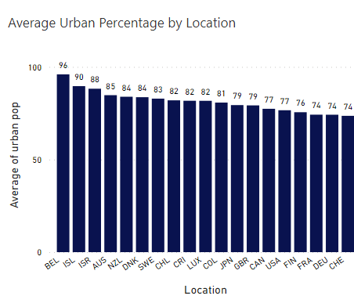
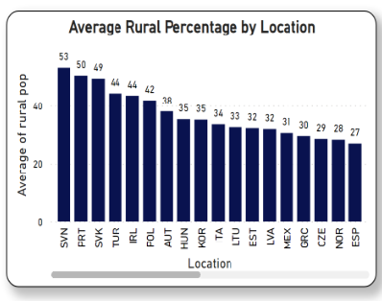
EDA Cont’d
Slovenia, Portugal, and Slovakia are the top three countries with the highest rural populations
Belgium, Iceland, and Israel stand out with the highest urban populations

Slide 10
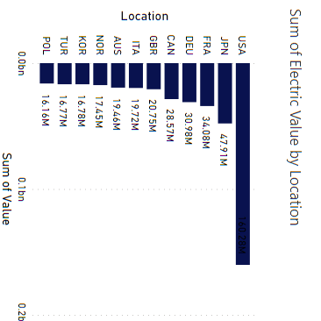
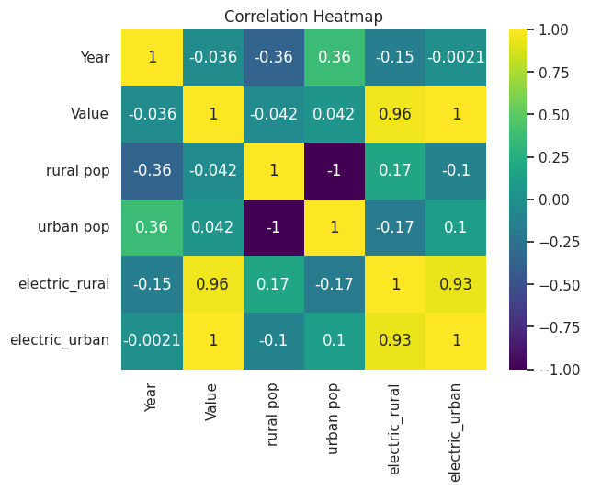
EDA Cont’d
There is a strong correlation between the 'Value' variable and both 'electric_rural' and 'electric_urban'. Similarly, 'electric_rural' and 'electric_urban' also exhibit a high degree of correlation.
USA, Japan, and France has the highest electric values

Slide 11
DATA PREPROCESSING
Data Transformation: The "Value" variable underwent transformation using the qcut method, resulting in categorical classes: Low, Medium, and High. This transformation facilitates an intuitive understanding of the data's distribution, aiding subsequent analyses.
Data Splitting: The dataset was divided into training and testing sets using the train-test split method. This separation ensures the evaluation of models on unseen data to gauge their generalization capabilities.
Label Encoding: Label encoding was applied to the categorical "Location" and “Value” column, converting them into numerical representations

Slide 12
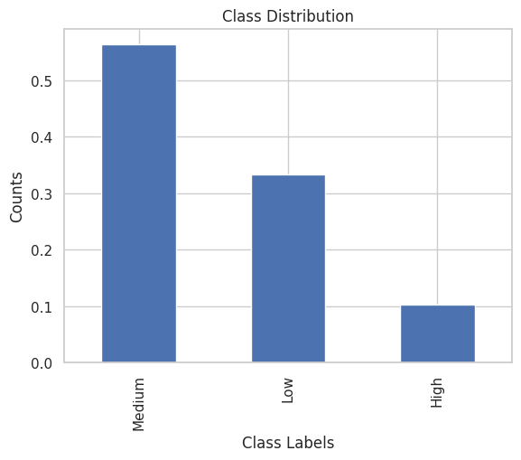
DATA PREPROCESSING Cont’d
Handling Class Imbalance: SMOTE (Synthetic Minority Over-sampling Technique) was employed to rectify class imbalance, enhancing model performance.
Feature Scaling: StandardScaler was employed to standardize numerical features, resulting in a mean of 0 and a standard deviation of 1.
Unbalanced target variable

Slide 13
MODEL DEVELOPMENT
Baseline Accuracy: The normalized maximum value count is computed to establish the baseline accuracy. The baseline accuracy is determined to be 0.5638, serving as a reference point for model performance evaluation.
Algorithm Comparison: Multiple classification algorithms were evaluated to gauge their performance. Notable models include Decision Tree Classifier (DTC), Random Forest Classifier (RFC), Gradient Boosting Classifier (GBC), and others. The algorithms were cross-validated, and their accuracy metrics are presented alongside mean and standard deviation values and a boxplot were plotted to provides a visual comparison of the accuracy results obtained from different algorithms

Slide 14
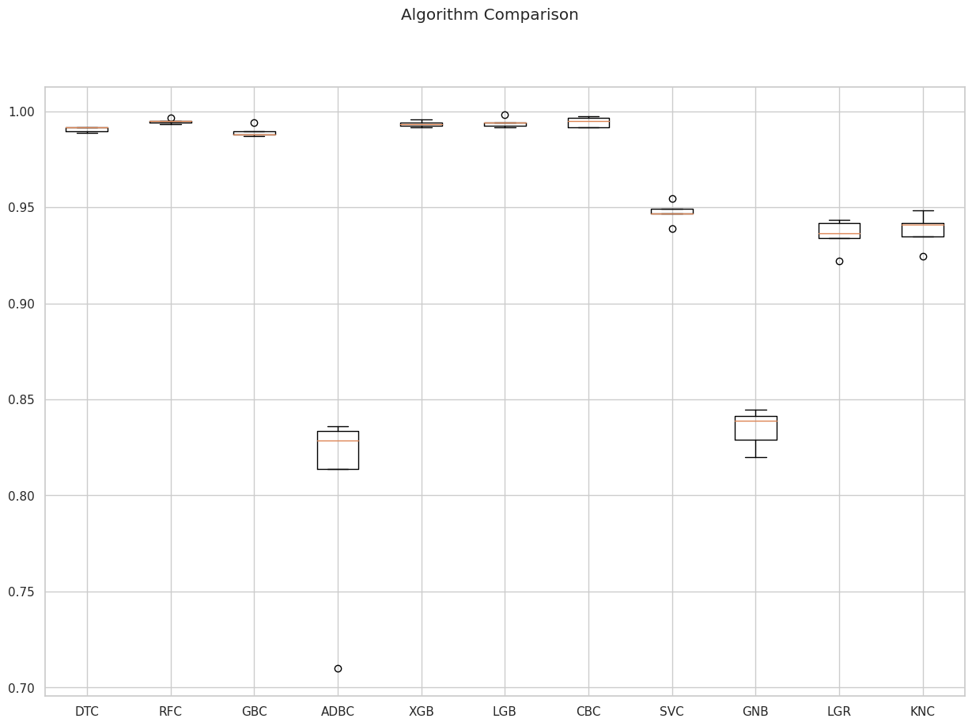
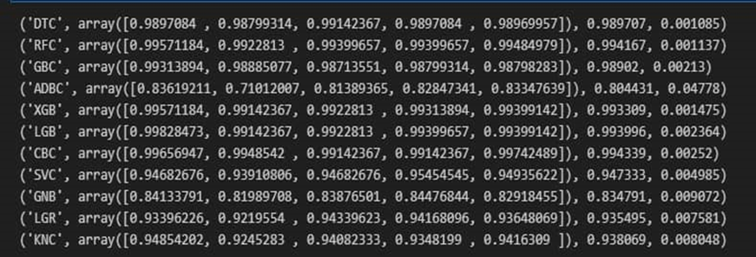
MODEL DEVELOPMENT Cont’d
The Algorith Result Comparism with box plot

Slide 15
MODEL DEVELOPMENT Cont’d
LGB Model Fitting: LightGBM (LGB) classifier was chosen for detailed evaluation. The model was fitted to the scaled training data, and its performance was assessed on both training and test sets.
Model Evaluation: The trained LGB model's accuracy was evaluated on both the training and test datasets. The training accuracy is 1.0, indicative of a well-fitted model. The test accuracy is 0.994, signifying strong generalization.
Confusion Matrix:
Classification Report:
Feature Importance:

Slide 16
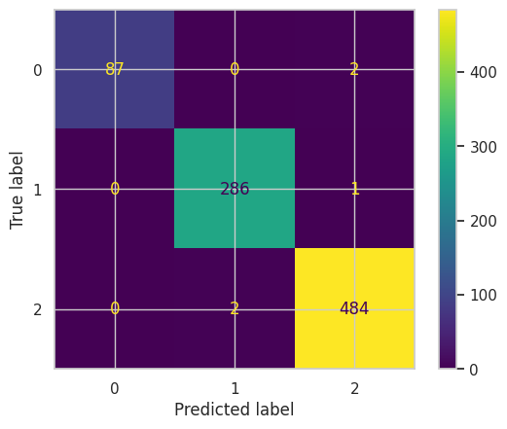
MODEL DEVELOPMENT Cont’d
precision recall f1-score support
0 1.00 0.98 0.99 89
1 0.99 1.00 0.99 287
2 0.99 1.00 0.99 486
accuracy 0.99 862
macro avg 1.00 0.99 0.99 862
weighted avg 0.99 0.99 0.99 862
The confusion matrix visually presents the model's performance across different classes. Each entry in the matrix represents the count of true positive, true negative, false positive, and false negative instances.
Classification Report

Slide 17
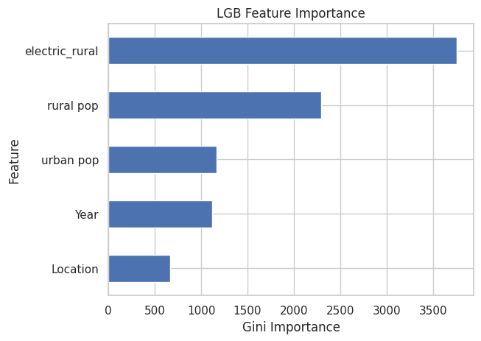
MODEL DEVELOPMENT Cont’d
Feature Importance

Slide 18
DEPLOYMENT
The process involved saving the model in Streamlit-compatible format (pickle file), creating an interactive Python script for the application, storing the code in a GitHub repository, connecting the repository to Streamlit for deployment, and enabling users to access the application through web hosting

Slide 19

APP DEMO VIDEO

Slide 20
CONCLUSION
This research centered on the application of various machine learning algorithms to predict electricity values within OECD countries, thereby contributing to the enhancement of household electricity provisioning. Based on the gathered insights, it is reasonable to conclude that the Light Gradient Boosting Machine outperforms the other machine learning algorithms employed in this investigation for predicting household electrification.

Slide 21
Links to the Other Documentation
Research article : https://docs.google.com/document/d/18_uIrVqsfzAET3wjd7lRaoK8dZETpv-eZ2sBKlTRNak/edit?usp=sharing
Power Bi: https://app.powerbi.com/groups/me/reports/4b2fba83-fa2f-426d-967f-cd953cf47803/ReportSection?experience=power-bi
Project Documentation: https://docs.google.com/document/d/1CNIaLIJcwzMxaKX30JzJrSmr7eJkF61kyNXkep5k7cc/edit?usp=drivesdk
GitHub: https://github.com/Adebesin-Aramide/Global_Household_Electrification
https://github.com/OBIGOD3931/Team-GCP-Hamoye-HDSC-Spring-23-Capstone-Project

Slide 22
Links to the Dataset
Given Dataset: https://www.iea.org/data-andstatistics/dataproduct/monthly-electricity-statistics
Electricity Generation Data: https://data.world/oecd/electricitygeneration/workspace/file?filename=electricity_generation.csv
World Bank Rural Population Percentage Data: https://data.worldbank.org/indicator/SP.RUR.TOTL.ZS?end=2022&start=2022&view=map

Slide 23

THANK YOU !!
Presentation by Team GCP

